Slide 1
Python for Physical Sciences Tutorial 2: Visualising Data with Matplotlib

Slide 2
Plotting data with Python
An important part of any scientific analysis is presenting data and results in a meaningful way, for example with graphs and figures.
Python provides many tools for creating graphical outputs in a number of different packages.
We will focus on one particular package – Matplotlib.

Slide 3
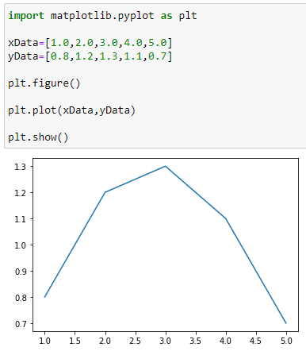
Basic plotting
First, load the matplotlib.pyplot package
-> import matplotlib.pyplot as plt
We define it as plt to avoid writing the full name for each function.
Setup up a figure/plotting canvas
-> plt.figure()
Plot some data
-> plt.plot(xData,yData)
This requires two lists – x coordinates and y coordinates. They must have the same number of elements.
Display the figure
-> plt.show()

Slide 4
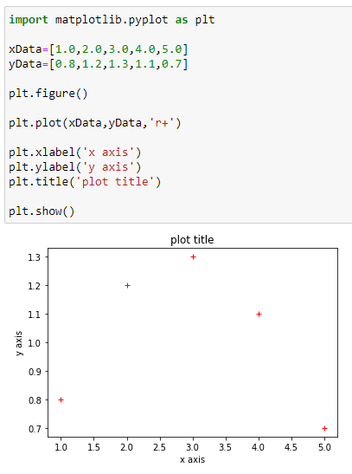
Simple improvements
Add a title and axis labels:
-> plt.xlabel(‘x axis’)
-> plt.ylabel(‘y axis’)
-> plt.title(‘plot title’)
We can also change the marker style and colour from within the plot function.
-> plt.plot(xData, yData, ’r+’)
Alternatively can define color and marker within plt.plot, i.e. -> plt.plot(xData, yData, color=‘r’, marker=‘+’)

Slide 5
Task – Testing Different Styles
Consider the following marker styles:
‘b.’
‘g--’
‘r+-’
‘ ‘
What would the data look like for each of these?

Slide 6
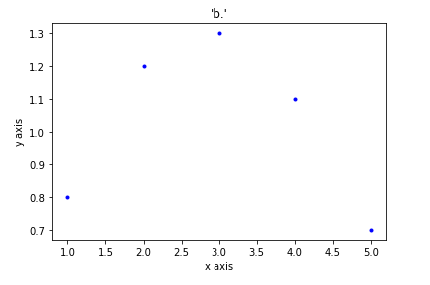
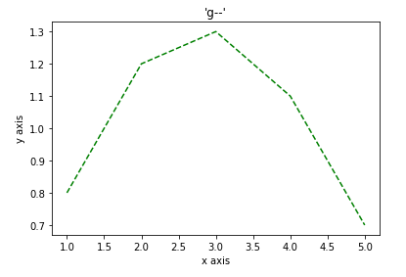
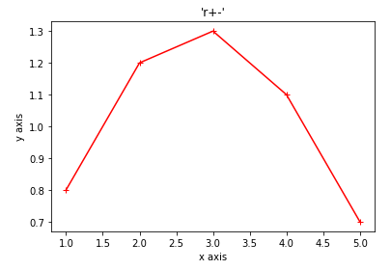
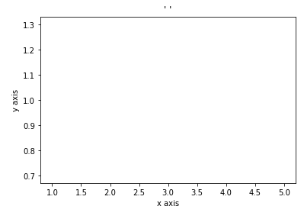
Notice anything about the axis scales?

Slide 7
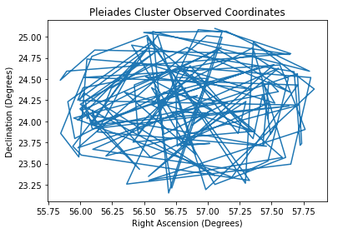
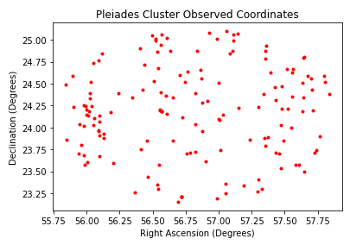
Real Example – Observed Star Coordinates
This doesn’t look good…
This is better!

Slide 8
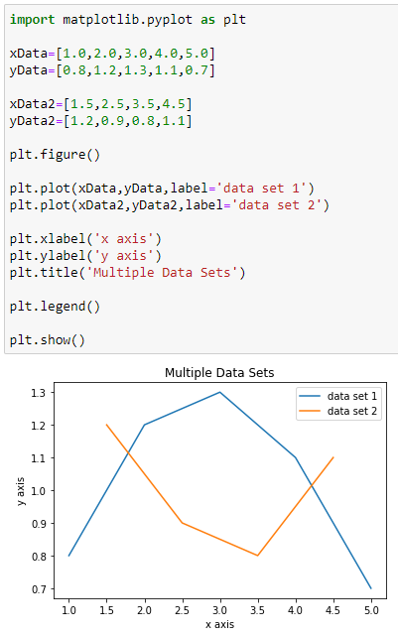
Multiple data sets
Use plt.plot again to plot more data on the same axes.
By default, these will be displayed in a different colour, but you can still manually set the colour and marker styles as before.
We can display a legend to distinguish each data set.
-> plt.legend()
This is placed automatically. You can also specify position for example with legend(loc=‘ul’).
Define the label for each dataset within the legend with plt.plot(…,label=‘Dataset 1’)
Can also use label=‘_nolabel_’ to not display a label for a dataset in the legend.

Slide 9
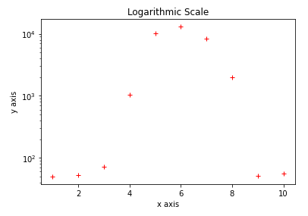
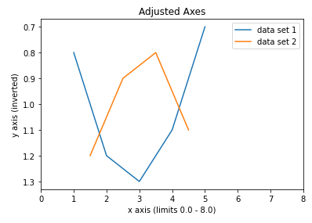
Adjusting axes
X and Y axis limits are normally set automatically based on data entered, but we can also define them manually .
i.e. -> plt.xlim([0,1]), plt.ylim([0,1])
We can also use these functions to display the current axis boundaries.
-> xLims=plt.xlim(), -> print(xLims)
We can convert to logarithmic scales.
-> plt.yscale(‘log’)
Inverting an axis.
-> plt.gca().invert_yaxis()
This is very important for photometric magnitude!

Slide 10
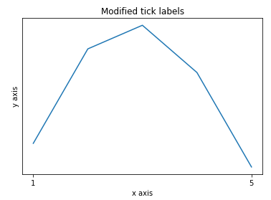
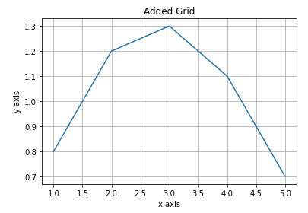
Additional useful functions
Manually set markers (‘ticks’) on an axis with plt.xticks() or yticks().
-> plt.xticks([0,5],labels=[‘0’,’5’])
Can also use this to not show any markers with plt.xticks([])
Add grid lines.
-> plt.grid()
Save your figures.
-> plt.savefig(‘your_plot_name.png’).
Important note: you cannot open and edit saved figures afterwards.

Slide 11
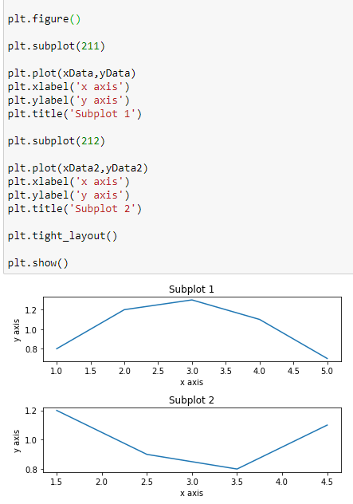
Subplots
We can use subplots to show two or more graphs in the same figure.
Define a subplot with:
-> plt.subplot(211)
Here we need to enter 3 integers – the first two define the arrangement of the subplots, while the third tells the program which we are working on.
All ‘plt.’ functions then apply to the specified subplot.
We switch to a different subplot by using plt.subplot() again, i.e. plt.subplot(212)
Extra tip: to maximise space usage with subplots, use:
-> plt.tight_layout()

Slide 12
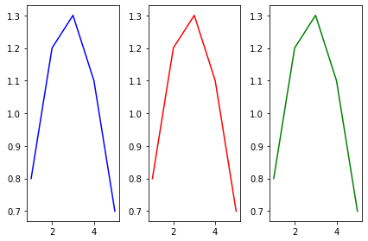
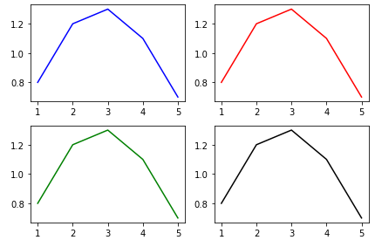
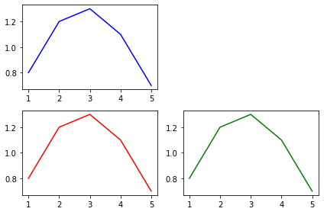
Task – Subplot Layouts
How would you make these?

Slide 13
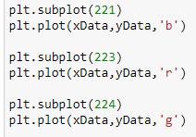
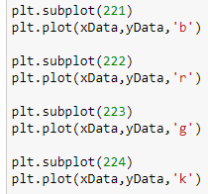
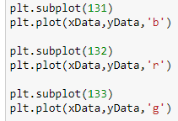

Slide 14
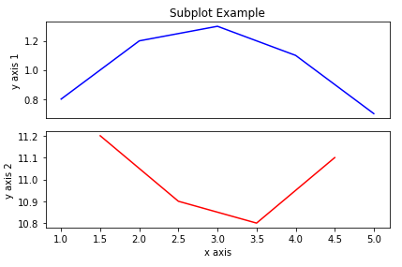

Task - More Advanced Subplot
How would you create this?
Hint: You need to make use of several concepts discussed earlier.

Slide 15
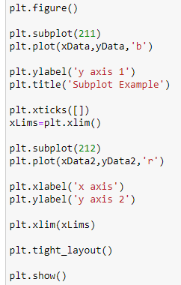
Task - More Advanced Subplot
Solution:
Remove x ticks and have no x axis label for first subplot.
Record the x axis limits for the first subplot, enter as the limits in the second

Slide 16
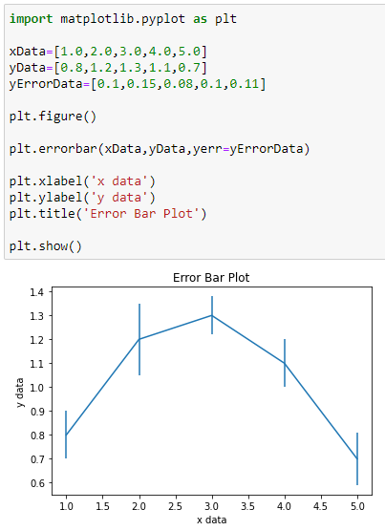
Different plotting function – ‘errorbar’
Matplotlib has many other plotting functions besides plt.plot(). For Physical Sciences, plt.errorbar() may be very useful.
This works very much plt.plot(), except we also enter uncertainty values:
-> plt.errorbar(xData,yData,yerr=yErrorData)
The colour and marker style must be changed with the ’fmt’ argument:
-> plt.errorbar(xData,yData,yerr=yErrorData,fmt=‘r.’)
Other specific style arguments for this function: ‘elinewidth’, ‘capsize’, ‘capthick’.

Slide 17
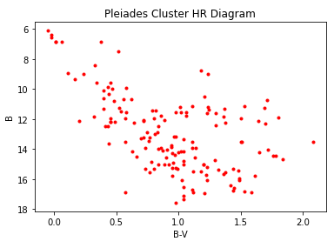
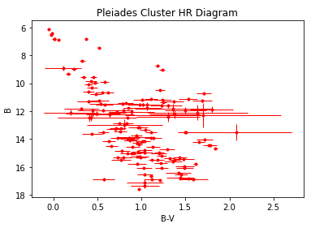
Real Example – HR Diagram
Without Error Bars
With Error Bars

